Slide 1
LA LOCAL HIRE
OVERVIEW
ALTERNATIVE PATHWAYS INTO CIVIL SERVICE CAREERS
Notes:
Hello, and thank you for your interest in the LA Local Hire Programs. We hope that you learn more about the Alternative Pathways into Civil Service Careers offered.

Slide 2
WHAT IS LA LOCAL HIRE?
LA Local Hire provides 2 different programs that offer alternative job pathways into civil service careers with the City of Los Angeles. They are:
Targeted Local Hire (“TLH”) Program
Bridge to Jobs (“BRIDGE”) Program
Notes:
So what is LA Local Hire? LA Local Hire is our initiative for connecting individuals to careers within the City of Los Angeles through alternative pathways. This is done with our two programs, Targeted Local Hire, and our newest program Bridge to Jobs. During the remainder of this video, we will refer to the Targeted Local Hire Program as the “TLH Program” and the Bridge to Jobs Program as “BRIDGE Program.”

Slide 3
TLH PROGRAM
MINIMUM REQUIREMENTS
Targeted Local Hire offers an opportunity to be directly referred to a City department for hiring consideration into an entry-level job .
No minimum work experience, education or training is required!
Only requirements are:
1. Valid Agency Referral Form from an approved Referral Agency!
2. Valid Referral Code assigned by the Application Site at the time of application.
3. Have a legal right to work in the U.S.
Notes:
Let’s begin with the TLH Program. The TLH program offers an opportunity to be directly referred to a city department for hiring consideration into an entry level job. There is no experience or education requirement to be a part of the program. The only requirements are as follows:
Having a valid agency referral form from an approved Referral Agency
Having a valid referral code assigned by the application site at the time of application
And having the legal right to work in the United States. You must have this legal right at the time you are hired if a job is offered to you, but is not necessary for applying to the program.

Slide 4
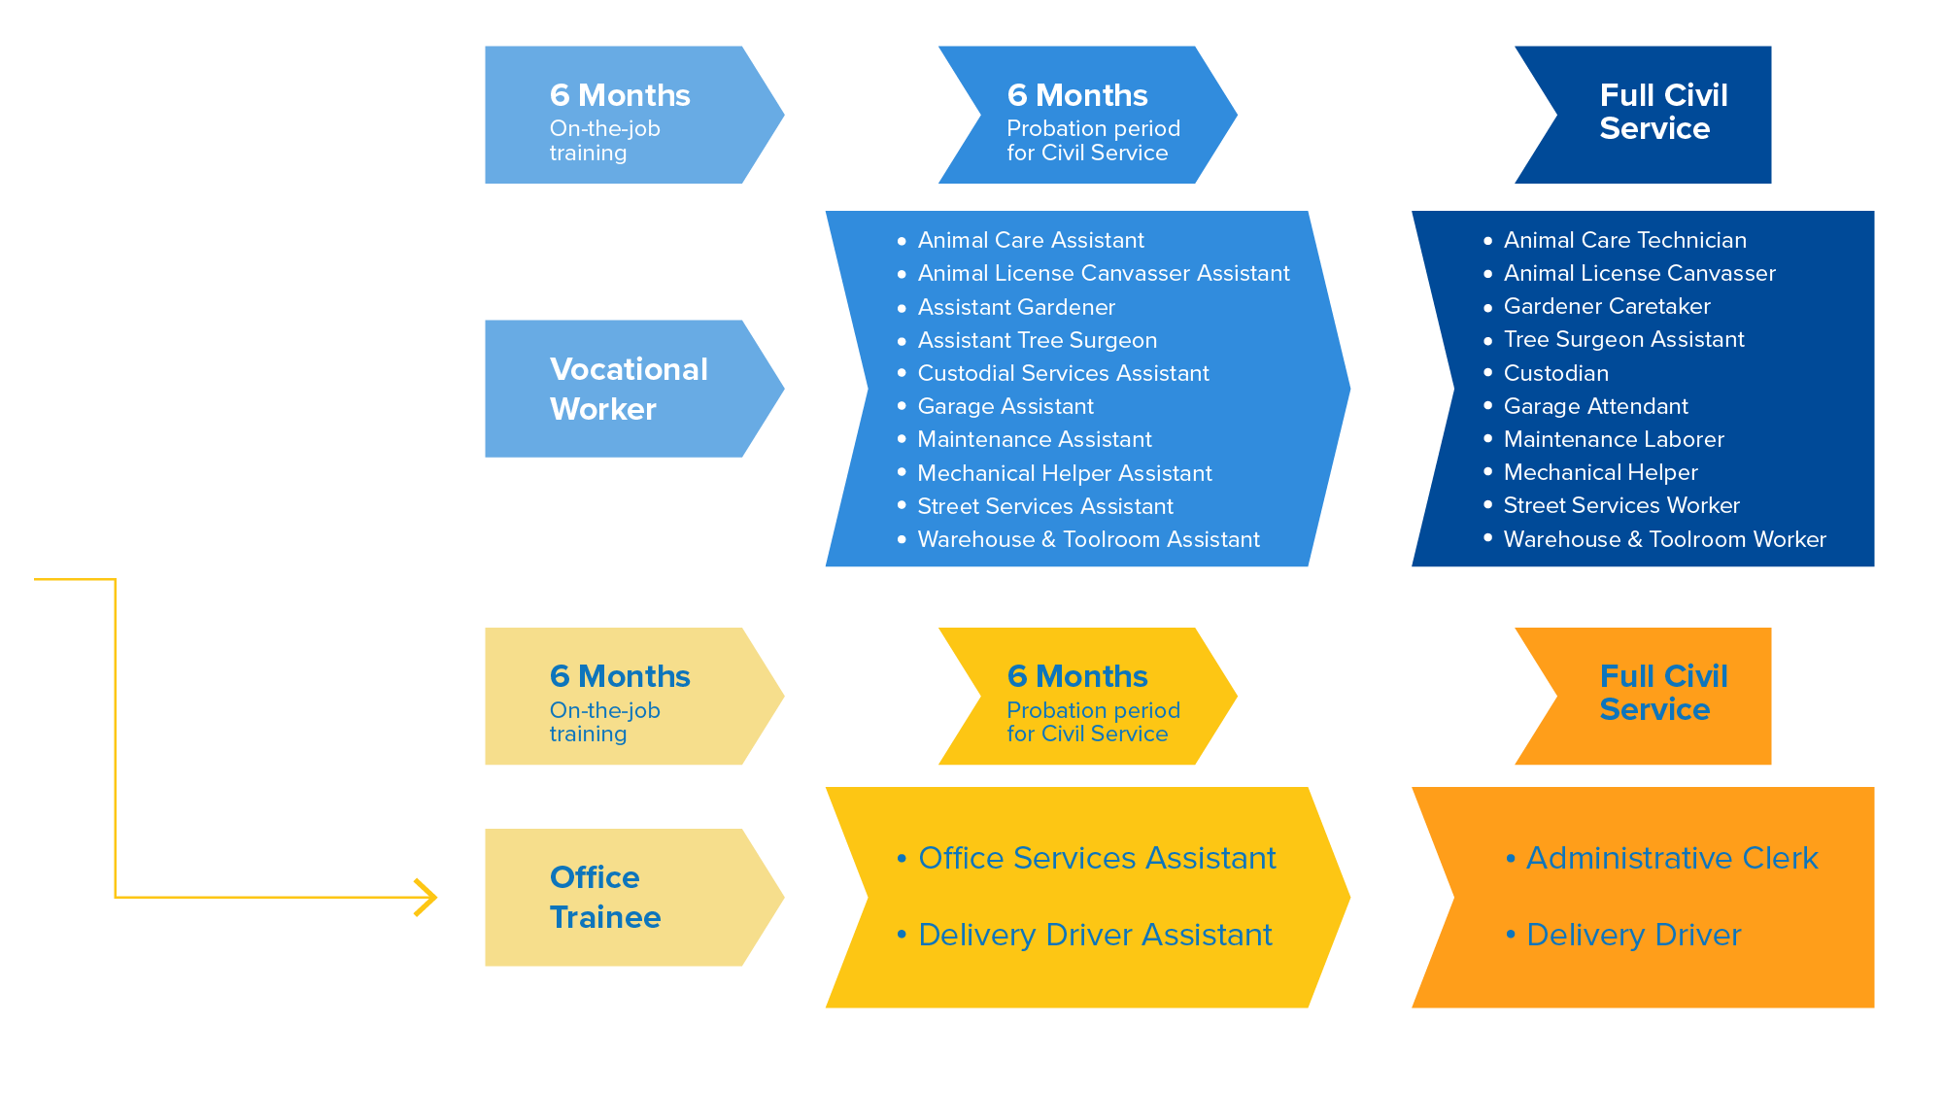
TARGETED LOCAL HIRE PROGRAM
Notes:
There are eleven available classifications through the TLH program. Some of the possible career options include:
Animal Care Assistant - Care for many types of domestic and wild animals. Typical tasks may include bathing animals, cleaning cages and facilities, transferring animals to shelters, helping with adoptions, and tending to healthy and sick animals.
Animal License Canvasser Assistant - Canvass residences and businesses for valid dog and equine licenses, collect license fees, and verify current rabies vaccinations and sterilization of dogs in the field.
Assistant Gardener - Assist with landscape construction and maintenance of City parks, playgrounds, traffic islands, and other landscaped areas.
Assistant Tree Surgeon- Assist in tree trimming and perform a variety of tasks on the ground.
Custodial Services Assistant - Perform a variety of cleaning and janitorial tasks in City buildings.
Garage Assistant- Work with cars, trucks, and motorcycles. Sample tasks include shuttling of passengers, parking cars, washing and waxing, and minor repairs.
Maintenance Assistant - Perform a variety of manual tasks for the City, such as assisting with construction and maintenance, and transporting materials and equipment.
Street Services Assistant - Help pave and slurry City roads, and make small asphalt repairs.
Warehouse & Toolroom Worker - Help order, receive, store, and account for materials, supplies, automotive parts, tools, and equipment.
Office Services Assistant - Perform general office work, which may include customer service, basic word processing, data entry, filing and organizing, and other related work.
Delivery Driver Assistant - Collect mail, supplies, and deliver other department materials. Drivers also collect water samples for use in laboratory tests, and prepare routine reports.
If hired through the TLH Program, employees will either begin as a Vocational Worker or an Office Trainee. During this 6-month period, TLH employees receive at least $15/hr with on the job training, pension and health benefits.
After successful completion of the OTJ training period, employees in the program will transition into one of the Assistant positions where they will serve a 6-month probationary period for civil service. Once the 6 month probation period is successfully completed, employees will then transfer into full civil service status and may apply for eligible transfers and promotions.

Slide 5
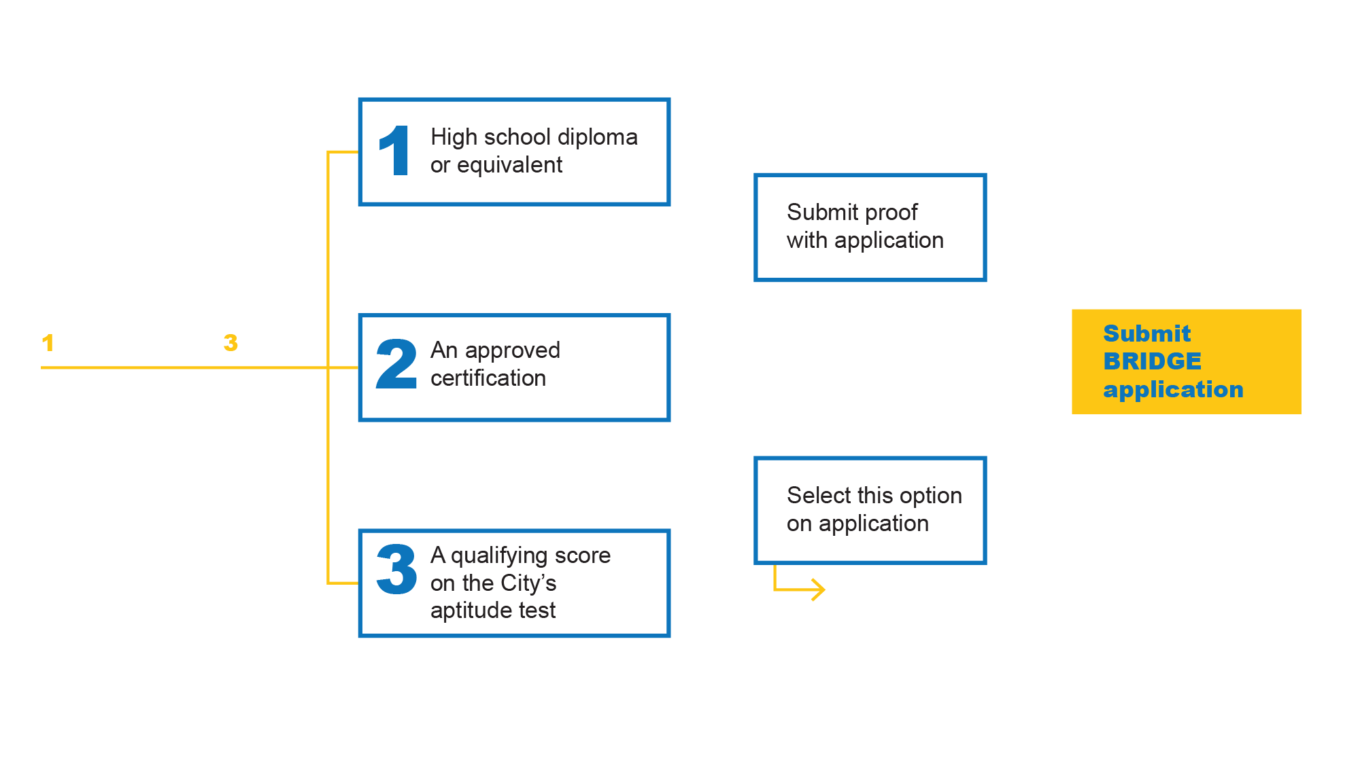
BRIDGE TO JOBS PROGRAM (BRIDGE) MINIMUM REQUIREMENTS
Bridge to Jobs offers an opportunity to be directly referred to a City department for hiring consideration into a semi-skilled job!
Minimum Requirements:
Notes:
LA Local Hire also offers the Bridge to Jobs Program, or ‘BRIDGE’, which provides individuals an opportunity to be directly referred to a city department for hiring consideration into a semi-skilled job.
Because BRIDGE provides alternative pathways into semi-skilled positions, individuals must meet 1 of the following 4 requirements:
Have obtained a high school diploma or equivalent issued by a US institution
If candidates have a high school diploma or equivalent from a US institution, proof must be submitted at the time that the BRIDGE online application is submitted. This means that candidates do not have to take the CASAS aptitude test or the City’s aptitude test.
Have an approved certification
If candidates have a specific certification approved by the City for one of the BRIDGE pathways, proof must be submitted at the time that the BRIDGE online application is submitted. This means that candidates do not have to take the CASAS aptitude test or the City’s aptitude test.
Have a qualifying score on the CASAS test that is administered by the Los Angeles Unified School District, Division of Adult and Career Education
If candidates wish to qualify for BRIDGE by taking the CASAS test, they must select this option on the BRIDGE online application. Candidates will receive an email with instructions on their test date and time after their online application is submitted.
Have a qualifying score on the City’s aptitude test
If candidates wish to qualify for BRIDGE by taking the City’s aptitude test, they must select this option on the BRIDGE online application. Candidates will receive an email with instructions on their test date and time after their online application is submitted.

Slide 6
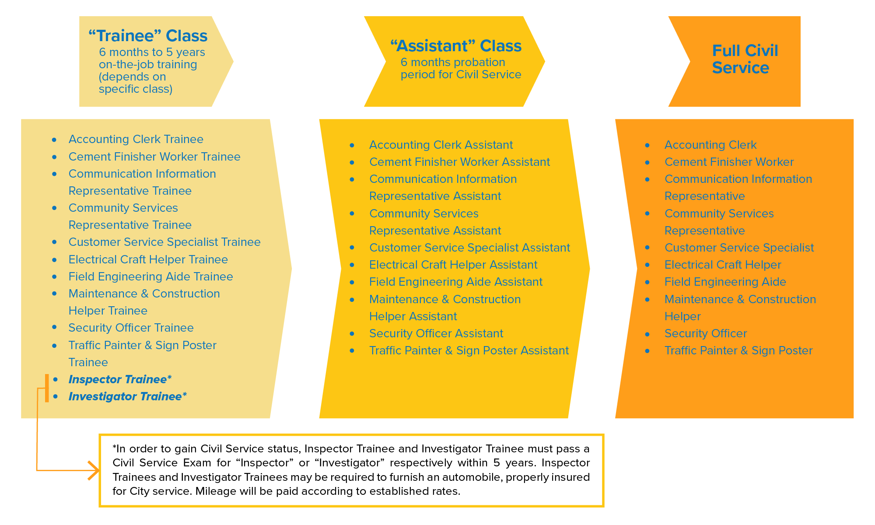
BRIDGE TO JOBS PROGRAM (BRIDGE)
Notes:
In the BRIDGE program, if you are hired you will begin in the “Trainee” class where you will receive on the job training for 6 months to 5 years depending on the specific class. During this 6 months to 5 years training period, you will receive at least $19/hr with on the job training, pension and health benefits. . Possible career options include:
Accounting Clerk – Performs clerical accounting work, maintenance of accounting records and reports, or payroll and time keeping documents; processes and monitors invoice payments, and personal services contract invoice payments; may perform cashiering duties; or may act as a lead person in the performance of such work.
Communication Information Representative - Receives and handles incoming calls or emails from the public and city employees through a two-way radio or central voice telephone communication system; Determines the required course of action for each call, such as providing information or routing calls to the proper station. These employees also relay information orally and in writing, enters and retrieves information from a computer based system, and performs clerical work.
Community Services Representative - Provide customer service and social service work including promoting City department’s special programs, services, and resources.
Electrical Craft Helper - Assist semi-skilled craft workers engaged in one of the electrical trades involved in construction, installation, maintenance, and/or repair of electrical systems, facilities, and equipment.
Field Engineering Aide – Performs sub-professional land surveying work or works with engineering personnel. May be required to climb fences, work in confined spaces, work with hot asphalt, and carry equipment long distances over various types of terrain; also may be trained to operate Data Collectors, and to set up and operate GPS receivers.
Inspector trainee - Assists Inspectors and receives training in various areas, including but not limited to: inspecting of buildings and structures, heating and refrigeration, electrical installations, perform owner and property record research, inspection of streets, storm drains, etc. Duties might differ slightly depending on the Department.
After you complete the on the job training period in a trainee class, you will be transitioned to an assistant class where, like the TLH program, you will serve your 6 month probationary period for civil service. After successful completion of the probation period, you will be transitioned into full civil service. Please note that for the inspector trainee classification, you must pass a civil service exam for “inspector” within 5 years of being hired as an Inspector Trainee. Civil service status is not automatic for Inspector Trainees. City Departments are ready to provide training that will help individuals prepare for “Inspector” civil service exam; however, the candidate must still pass the exam in order to obtain a permanent civil service job. Upon being hired as an Inspector Trainee, individuals may be required to furnish an automobile, properly insured for City service. Mileage will be paid according to established rates.

Slide 7
WHO CAN APPLY?
Open to Everyone and Anyone meeting the requirements for desired position!
Contact LA Local Hire staff at lalocalhire@lacity.org if you have additional questions about the referral procedures.
Notes:
So who can apply to these two programs? They are open to everyone and anyone who meets the requirements for the desired position! Both programs aim to remove barriers to employment, so any applicant identifying with one or more of our targeted populations will have a higher chance to receive a referral. If you have any questions about what we covered, about the differences between programs, what is needed to apply, exam information, please contact the Personnel Department at lalocalhire@lacity.org.

Slide 8
WHO CAN APPLY? (Cont’d)
Targeted populations will have a higher chance of being referred
Information about whether or not a candidate is part of a targeted populations is NOT shared with anyone. It is collected for tracking purposes only and only the WorkSource Centers and Personnel Department will have access to this confidential information.
Identifying yourself as a member of a targeted population is NOT mandatory but it is beneficial
Contact LA Local Hire staff at lalocalhire@lacity.org if you have additional questions about the referral procedures.
Notes:
Please note that:
Targeted populations will have a higher chance of being referred
Information about whether or not a candidate is part of a targeted population is NOT shared with anyone. It is collected for tracking purposes only and only the WorkSource Centers and Personnel Department will have access to this confidential information
Identifying yourself as a member of a targeted population is NOT mandatory but it is beneficial

Slide 9
APPLICATION PROCESS OVERVIEW
Tier 1 – targeted categories
Tier 2 – general or did not disclose
Notes:
In order to apply for the Targeted Local Hire (TLH) Program and/or the Bridge to Jobs Program (BRIDGE), candidates must take the following steps:
Visit a Referral Agency to go through a Job Readiness Assessment. If deemed job ready, candidates will be issued either a TLH Referral Form and/or a BRIDGE Referral Form (Note: a unique referral form is required for each program)
Call and make an appointment at an approved Application Site. Candidates will need to make an appointment to attend the TLH & BRIDGE Orientation and Application Session.
Attend the TLH & Bridge Orientation & Application session. Candidates must bring their original Agency Referral Form in order to submit their application. Additionally, candidates may have to bring the following depending on the program they want to apply for:
For TLH – Candidates will be able to submit their TLH application as long as they have a valid Agency Referral Form
For BRIDGE – On the online BRIDGE application, candidates will select which one (1) of the four (4) BRIDGE requirements they fulfill:
High School Diploma or Equivalent (issued by a US institution)
Candidate must bring proof of their high school diploma or equivalent issued by a US institution. Proof may include bringing their original high school diploma, official transcripts, or other official documentation showing that they have a high school diploma or equivalent. Staff at the Application Site will help collect the proof and help candidates submit it with their application.
Candidates do not have to take the CASAS test or City’s Aptitude test if they have proof of a High School diploma/equivalent or an approved certification.
Approved Certification
Candidate must bring proof of their certification approved by the City for a specific BRIDGE career pathway. Proof may include bringing their original certificate, official transcripts, or other official documentation showing that they have the certification. Staff at the Application Site will help collect the proof and help candidates submit it with their application.
Candidates do not have to take the CASAS test or City’s Aptitude test if they have proof of a High School diploma/equivalent or an approved certification.
CASAS Test
Candidates may choose to take the CASAS Test and select this option on the online application. If they choose to take the CASAS Test, they will receive an email with information on their CASAS test date and time at a later time. Please inform candidates the importance of checking their email on a regular basis.
City’s Aptitude Test
Candidates may choose to take the City’s Aptitude Test and select this option on the online application. If they choose to take the CASAS Test, they will receive an email with information on their CASAS test date and time at a later time. Please inform candidates the importance of checking their email on a regular basis.
After you application is approved for the TLH and/or BRIDGE Program, you will be placed in the candidate pool.

Slide 10
WHERE TO APPLY FOR TLH AND/OR BRIDGE
CENTRAL & EAST LOS ANGELES
Boyle Heights, East Los Angeles 1505 East 1st Street Los Angeles CA 90033 323-267-5930 Operated by: Managed Career Solutions, Inc (MCS) | Pico Union, Downtown Los Angeles 1055 Wilshire Boulevard, #900-A Los Angeles CA 90017 213-353-1677 Operated by: Pacific Asian Consortium in Employment (PACE)
Hollywood 4311 Melrose Avenue Los Angeles CA 90029 323-454-6100 323-454-6198 Operated by: Managed Career Solutions, Inc (MCS) | Northeast Los Angeles 342 North San Fernando Road Los Angeles CA 90031 David A. Torrez 323-223-1211 Ext. 2365 Brenda Espiritu 323-223-12211 Ext. 2173 Charlene Cordova 323-539-2000 TTY 711 Operated by: Goodwill Industries of Southern California
Notes:
There are 16 WorkSource Centers/application sites located in the Los Angeles area, San Fernando Valley, and Harbor.

Slide 11
WHERE TO APPLY FOR TLH AND/OR BRIDGE
SOUTH & WEST LOS ANGELES
South Los Angeles 1512 West Slauson Avenue Los Angeles CA 90047 (323)730-7900 Operated by: UAW Labor Employment and Training Corporation | Watts Los Angeles 2220 East 114th Street Los Angeles CA 90059 323-249-7751 Operated by: LA City Housing Authority (HACLA) located at Imperial Courts | Vernon Central at Los Angeles Trade Technical College 400 West Washington Boulevard Los Angeles CA 90015 213-763-5951 Operated by: Coalition for Responsible Community Development (CRCD) located in Redwood Hall
Southeast Los Angeles 10950 South Central Avenue Los Angeles CA 90059 323-563-4702 Operated by: Watts Labor Community Action Committee (WLCAC) | South Los Angeles Portal 5849 Crocker Street, unit X Los Angeles CA 90003 323-432-4399 Operated by: UAW Labor Employment and Training Corporation | West Adams 2900 South Crenshaw Boulevard Los Angeles CA 90016 323-293-6284 Operated by: Asian American Drug Abuse Program, Inc (AADAP)
West Los Angeles 5446 Sepulveda Boulevard Culver City CA 90230 310-309-6000 ext. 0 Operated by: Jewish Vocational Service Los Angeles (JVS)

Slide 12
WHERE TO APPLY FOR TLH AND/OR BRIDGE
HARBOR
Harbor Gateway 222 West 6th Street, #410 San Pedro CA 90731 562-570-3756 562-570-3749 310-732-5700 Operated by: Pacific-Gateway
SAN FERNANDO VALLEY
Pacoima, Northeast Valley 12502 Van Nuys Boulevard Pacoima CA 91331 818-482-1754 711 for TRS Operated by: Goodwill Industries of Southern California | Canoga Park, South Valley 21010 Van Owen Street Canoga Park CA 91303 818-596-4110 818-596-4448 Operated by: Equus Workforce Services | Sun Valley, Southeast Valley 9024 Laurel Canyon Blvd Sun Valley CA 91352 818-504-0334 711 for TRS 818-504-2625 ext. 108 Operated by: El Proyecto del Barrio, Inc

Slide 13
These WorkSource Centers act as your personal employment agency and their services are always free. We encourage that candidates enroll with their WorkSource Center to benefit from the supportive services and resources available!
Employment Support
Job Training, Resume Building and Interview Skills
Phone and Computer Access, Skills Workshops
Employment Referrals
Career Guidance and Placement Assistance
Customize Job Matching
WorkSource Centers offer assistance in multiple languages, including Armenian, Farsi, Korean, Russian, Spanish and Tagalog. Find more information about the centers below:
https://lalocalhire.lacity.org/target-local-hire/resources
https://ewddlacity.com/

Slide 14
WHAT TO EXPECT
AT THE APPLICATION SITE
Staff that is ready to help you!
Supportive Services
Career Services
Help with the TLH and BRIDGE Program Application
What if I only want to apply for the Program?
Staff can help with the application only!
Register with your WorkSource Center to benefit from Employment Support!
Notes:
When you go to one of our application sites, you will find staff that is ready to help you with the application, including providing you with a valid referral code! If you require additional services, you may visit your original service provider. If you have questions about the program or city employment, you may also visit your original service provider. Please be reminded that you must call ahead of time because an appointment may be needed!

Slide 15
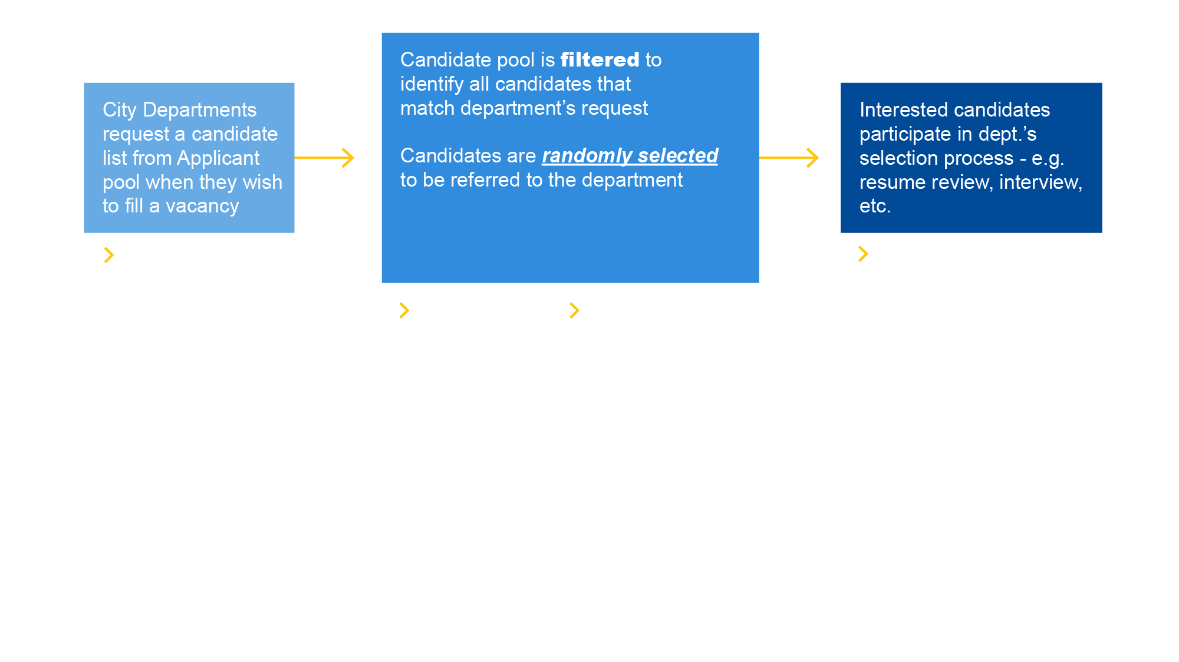
WHAT HAPPENS NEXT?
REFERRAL AND HIRING PROCESS
After your application is approved for the TLH and/or BRIDGE Program, you will be in the candidate pool waiting to be randomly selected for referral to City Departments for hiring consideration.
Notes:
What happens next? After your application is approved for the TLH and/or BRIDGE Program, you will be in the candidate pool waiting to be randomly selected for referral to City departments for hiring consideration. The time it takes to receive a referral depends solely on the hiring needs of the departments. If there are vacancies, it may be sooner. If there are no vacancies, it may take months or up to a year or longer. There is not a specific number of jobs that are available at any given time; it all depends on the on-going vacancies available at City Departments. Please check your e-mail address and text messages or sign up at a WorkSource Center for a Case Manager to ensure that you do not miss any opportunities!
If candidates have not been referred after one year, they will be given the option to renew their application via an email notification 30 days before it expires. If candidates wish to renew their application, all they have to do is click the button in the notice.
Please remember that the LA Local Hire Programs do not guarantee a job. They provide an opportunity to be referred for a long-term career with the City. The candidate pool and referral procedures are handled by the Personnel Department, NOT the WorkSource Centers.
If candidates need immediate work, WorkSource Center staff may help with career search while waiting in the candidate pool for the Targeted Local Hire Program and/or the Bridge to Jobs Program. Candidates will remain eligible for referral opportunities even if they have a job elsewhere, as long as they have an active application.

Slide 16
TLH & BRIDGE CONDITIONS OF EMPLOYMENT
Notes:
The TLH and BRIDGE programs both have the same conditions of employment. All candidates who are offered a tentative job offer must pass a background review, have the legal right to work in the U.S., and must meet the COVID-19 vaccination requirements in accordance with Los Angeles City Ordinance 187134. If you do not meet either of these requirements by the time you would start working, then you will not be able to work for the City of Los Angeles.

Slide 17
IMPORTANT REMINDERS
TLH and BRIDGE are an opportunity to be part of a candidate pool from which candidates will be randomly selected to participate in the hiring process with a City Department.
IMPORTANT NOTICE
City jobs are not guaranteed
Applications are active for one (1) year
Applications can be renewed after one (1) year.
The number of referrals will depend on the number of vacancies available.
Notes:
Please keep them in mind when applying to either the TLH or BRIDGE program. TLH and BRIDGE are an opportunity to be part of a candidate pool from which candidates will be randomly selected to participate in the hiring process with a City Department.
City jobs are NOT GUARANTEED.
Candidates’ application will be active for one year once it has been approved. If candidates are not offered a job with a city department and accept within one year, candidates may renew their application after one year. The number of referrals will depend on the number of vacancies available.

Slide 18
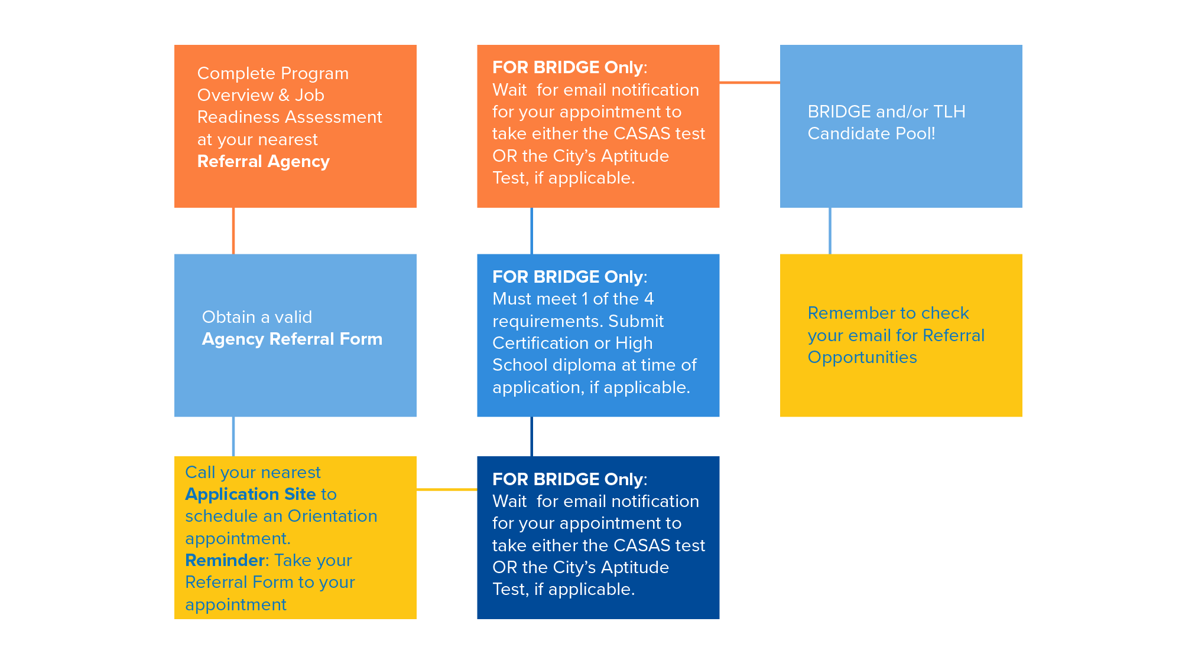
LET’S RECAP! TO APPLY FOR TLH AND/OR BRIDGE
YOU NEED THE FOLLOWING
Notes:
Let’s recap! To apply for TLH and/or Bridge, you need to take the following steps:
1. Complete the Program Overview and Job Readiness Assessment at your nearest Referral Agency
2. Obtain a valid Agency Referral Form
3. Call your nearest Application Site to schedule an orientation appointment. Please be reminded to take your referral form to your appointment.
4. Submit your application for TLH and/or BRIDGE
a. For BRIDGE: you must meet 1 of the 4 requirements. Submit certification or high school diploma at the of application, if applicable.
b. Wait for an email notification for your appointment to take either the CASAS test or the City’s Aptitude test, if applicable.
5. After you application is approved for the TLH and/or BRIDGE Program, you will be placed in the candidate pool.
6. Remember to check your email for referral opportunities!

Slide 19
NEXT STEPS
Visit your nearest designated Application Site for more information on the Application for TLH and/or BRIDGE!
Notes:
Visit your nearest designated Application Site for more information on the Application for TLH and/or BRIDGE! When you are referred to an Application Site, please be ready to discuss your employment preferences to help select the careers you want to apply for through the Targeted Local Hire Program or the Bridge to Jobs Program.

Slide 20
QUESTIONS
Notes:
Thank you for attending the LA Local Hire Program Orientation. If you have any questions, please feel free to email us anytime at lalocalhire@lacity.org.

